Slide 1
ENERGY CONSUMPTION ACROSS
BUILDINGS
DATA ANALYSIS ESSENTIALS
TEAM MEMBERS
25B11CS718 – PASALA HARINI
25B11CS517 – LAVETI ROSHINI
25B11CS623 – MUPPANABOINA VAMSI KALYAN
25B11CS700 – PALIVELA PRAHARSHA SAI CHARAN
UNDER THE SUPERVISION OF
K Vydehi
Assistant Professor
Department of CSE

Slide 2
PROBLEM STATEMENT
Buildings account for a significant portion of global energy consumption, yet many operate inefficiently due to factors such as occupancy patterns, weather conditions, building type, and equipment usage. Without proper analysis, it is difficult to identify energy wastage and opportunities for optimization. This project aims to analyze energy consumption across different buildings to uncover patterns, detect abnormalities, and provide data-driven recommendations for improving energy efficiency and reducing operational costs.

Slide 3
OBJECTIVES
Collect and analyze energy consumption data from multiple buildings.
Compare energy usage across different building types (e.g., residential, commercial, educational).
Identify the key factors influencing energy consumption, such as occupancy, weather, time of day, and building characteristics.
Detect unusual or excessive energy usage patterns using exploratory data analysis.
Visualize energy consumption trends through charts and dashboards.
Develop insights and recommendations to improve energy efficiency and reduce energy costs.
Demonstrate how data analytics can support sustainable energy management and decision-making.

Slide 4
DOMAIN SELECTION
The selected domain for this project is Energy Management and Building Analytics. This domain focuses on monitoring, analyzing, and optimizing energy consumption in residential, commercial, and institutional buildings. With the increasing demand for energy and growing environmental concerns, analyzing building energy usage has become essential for improving efficiency and promoting sustainable development.

Slide 5
IMPORTANCE OF THE PROBLEM
Buildings consume nearly 30–40% of the world's total energy, making them one of the largest contributors to energy demand and carbon emissions. Many buildings experience unnecessary energy wastage due to inefficient equipment, poor operational practices, and lack of monitoring. By analyzing energy consumption data, organizations can:
Identify inefficient buildings and equipment.
Detect abnormal or excessive energy usage.
Reduce electricity costs through informed decision-making.
Improve energy efficiency and sustainability.
Support environmental goals by reducing carbon emissions

Slide 6
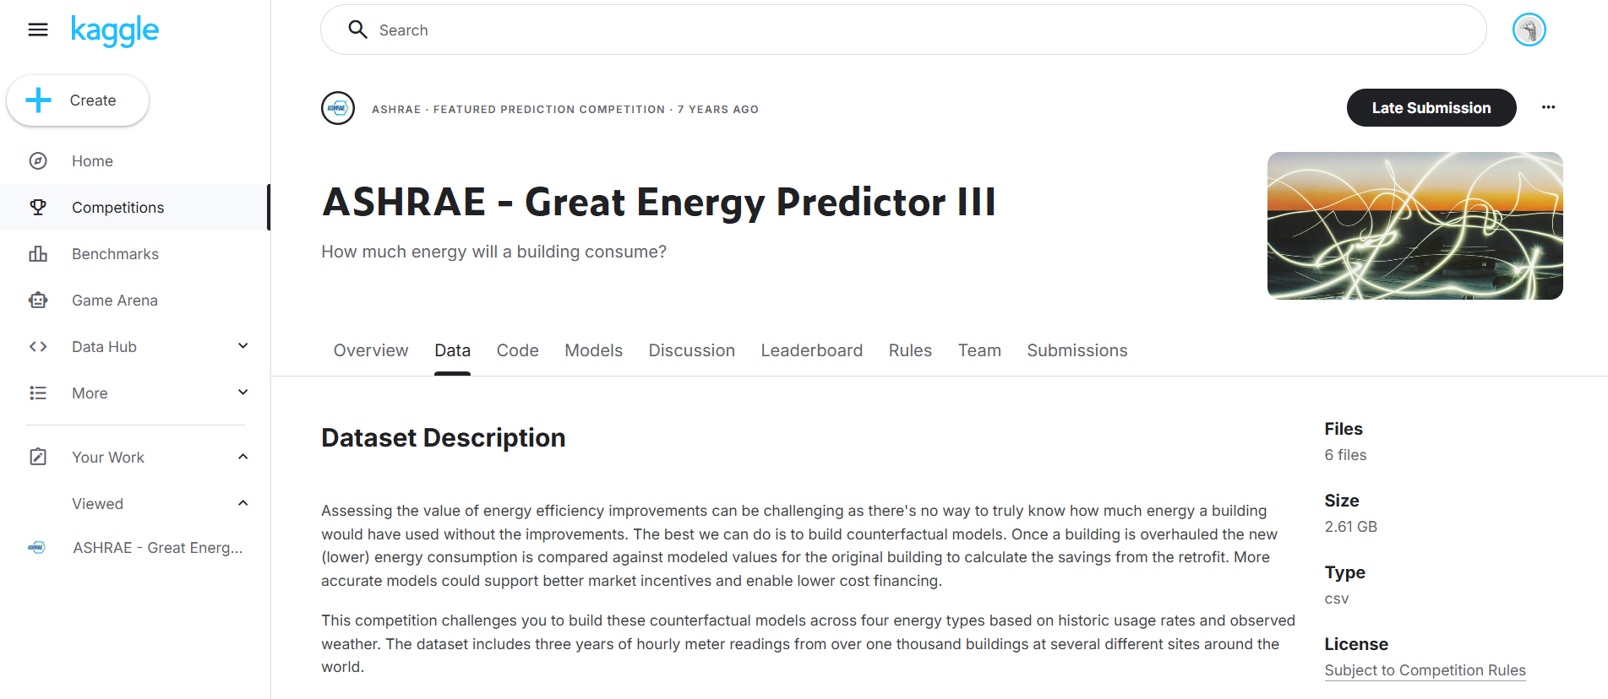
DATASET SELECTION AND
UNDERSTANDING
The dataset is sourced from Kaggle, hosted as part of a competition organized by ASHRAE — the American Society of Heating, Refrigerating and Air-Conditioning Engineers. ASHRAE was founded in 1894 to advance the science of heating, ventilation, air conditioning, and refrigeration, and the competition challenged data scientists worldwide to develop accurate models of metered building energy usage across electricity, chilled water, hot water, and steam meters. It comes structured across multiple CSV files covering building metadata, weather data, and meter readings.

Slide 7
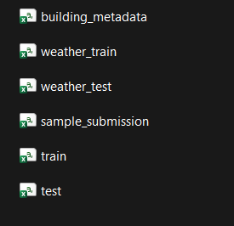
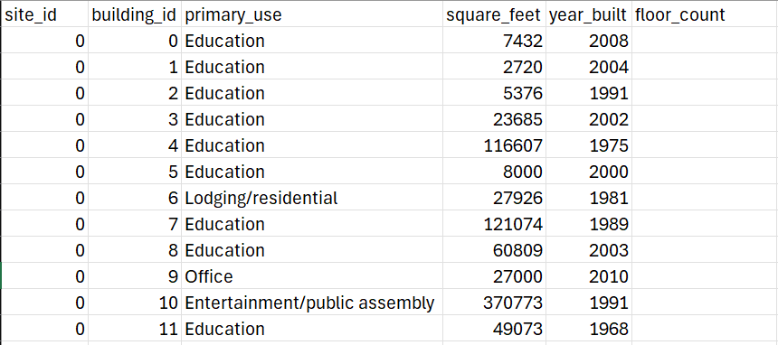
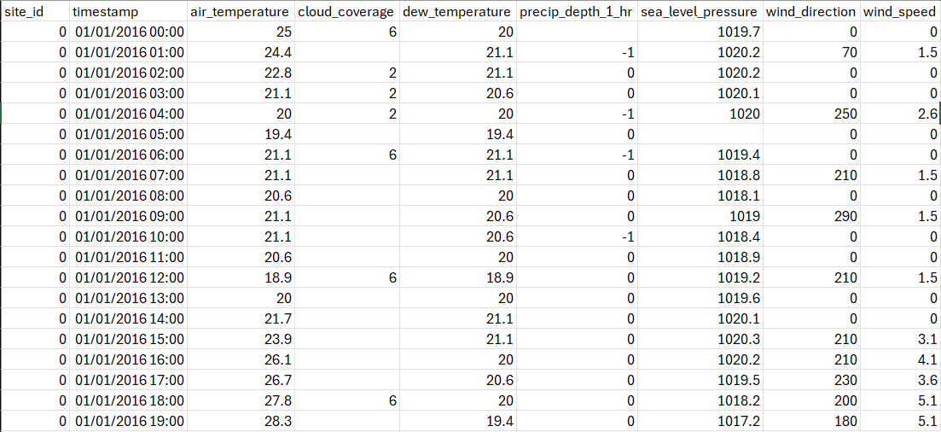
DATASET SELECTION AND
UNDERSTANDING
The dataset contains several key attributes that together paint a full picture of a building's energy behaviour, building_id uniquely identifies each building; square_feet captures the floor area; year_built and floor_count describe the building's physical profile; air_temperature and dew_temperature capture outdoor climate conditions; cloud_coverage, wind_speed, wind_direction, sealevel_pressure , and precip_depth_1_hr complete the weather picture; and meter identifies the type of energy being measured — electricity, chilled water, steam, or hot water. The primary_use attribute describes what the building is used for — office, education, healthcare, and so on — which is critical for comparing consumption across building types. The target variable is meter_reading, which represents the actual energy consumed in kWh, and this is what our predictive model will learn to estimate based on all the other features.

Slide 8
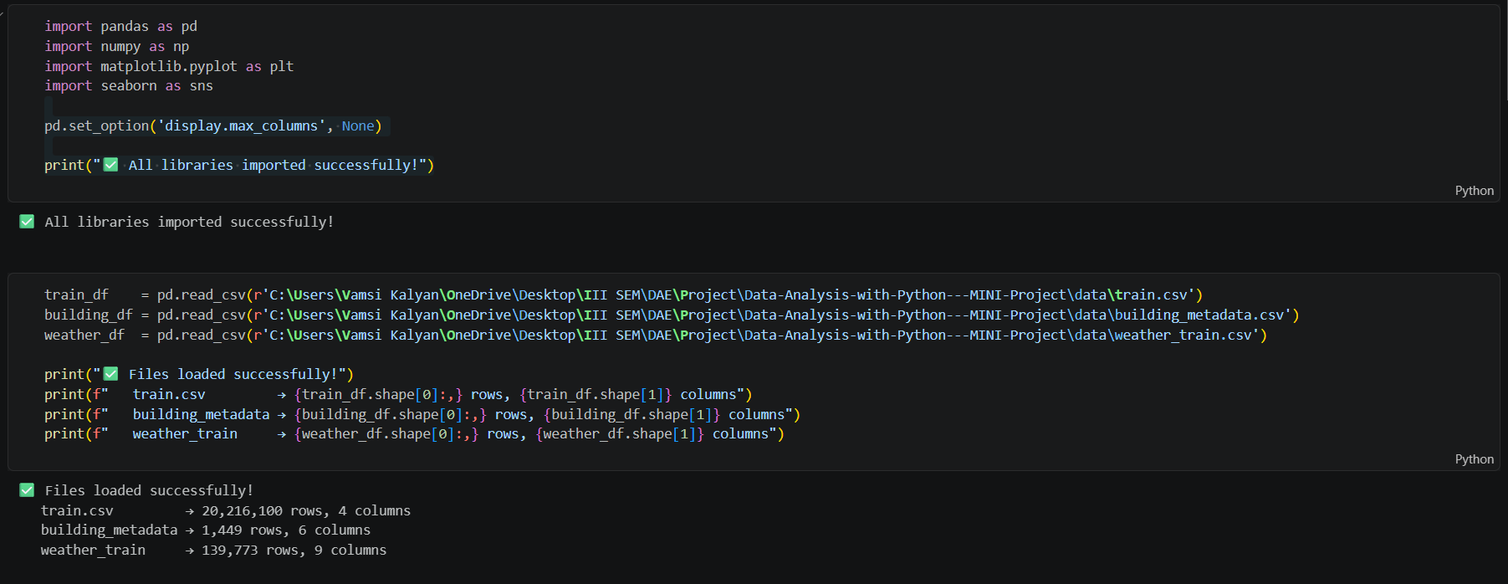
DATA COLLECTION AND
PROCESSING
Dataset Import
The ASHRAE dataset was downloaded from Kaggle and imported into a Jupyter Notebook using Python's pandas library (pd.read_csv()). The files (train.csv, building_metadata.csv, and weather_train.csv) were merged using pd.merge() to create a unified dataset for analysis.

Slide 9
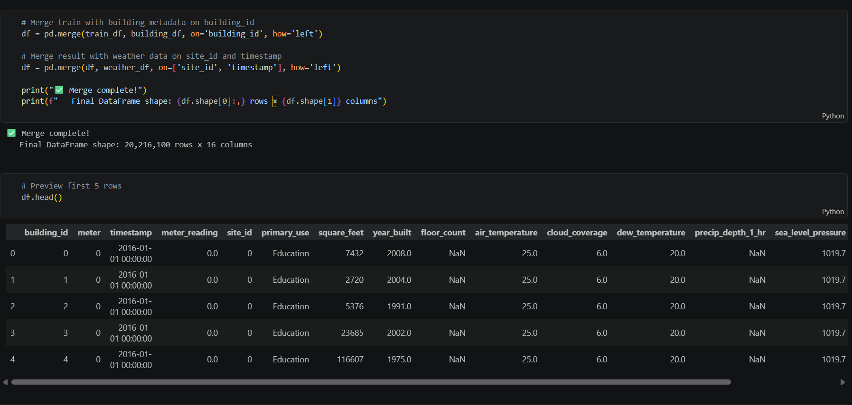
DATA COLLECTION AND
PROCESSING

Slide 10
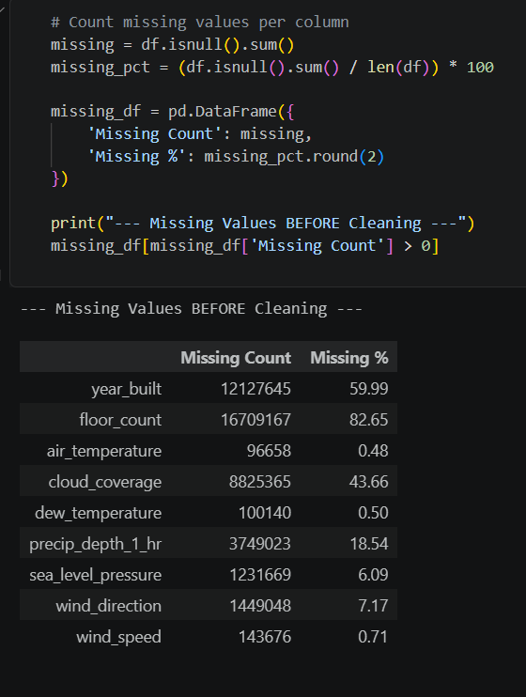
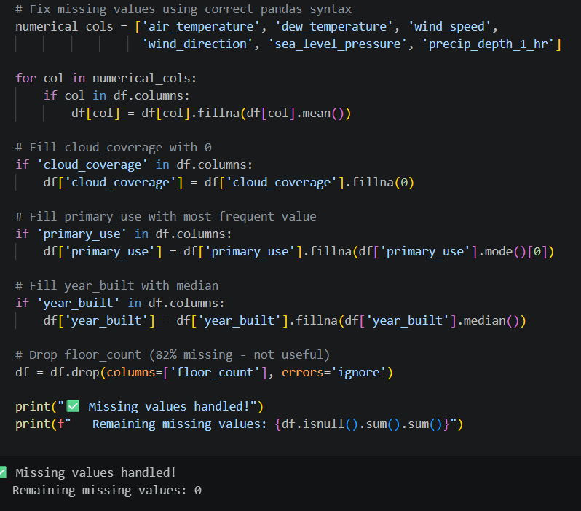
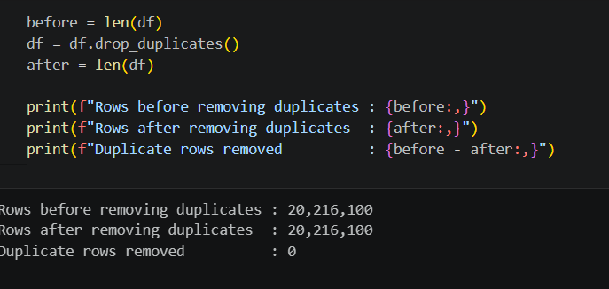
DATA COLLECTION AND
PROCESSING
Data Cleaning
The dataset was inspected using df.info(), df.describe(), and df.head(). Columns with excessive missing values (e.g., floor_count, year_built) were dropped or imputed. Invalid records, such as negative meter_reading values, and duplicate rows were removed.

Slide 11
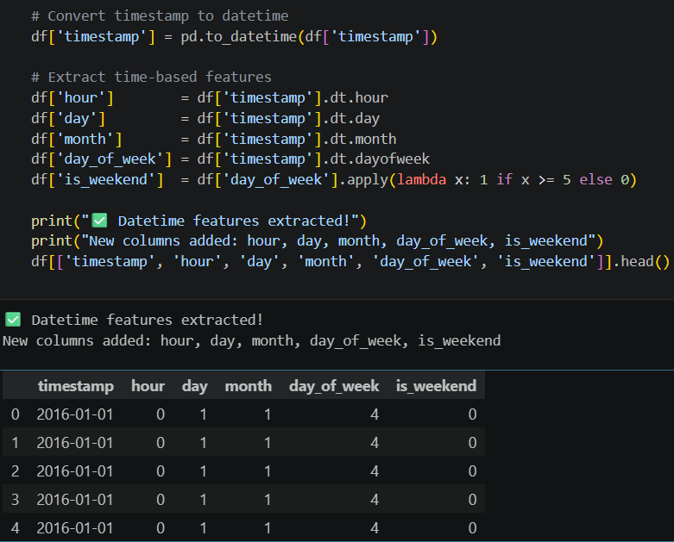
DATA COLLECTION AND
PROCESSING
Handling Missing Values and Outliers
Missing numerical values were filled with the mean, while categorical values were filled with the mode. Duplicate records were removed using drop_duplicates(). Outliers in meter_reading were detected and removed.
Data Transformation and Preprocessing
The timestamp column was converted to datetime format, and new features such as hour, day, month, and day of the week were extracted.

Slide 12
CONCLUSION
This project analyzed energy consumption across buildings to identify usage patterns and the factors influencing energy demand. Through data cleaning, preprocessing, exploratory data analysis, and visualization, valuable insights were obtained regarding how building characteristics, occupancy, weather conditions, and time-based factors affect energy consumption.
The analysis highlighted opportunities to detect inefficient energy usage, compare building performance, and identify potential energy-saving measures. These insights can help building managers and organizations make informed decisions to optimize energy consumption, reduce operational costs, and support sustainable energy management.
Overall, the project demonstrates how data analytics can transform raw energy data into actionable insights, contributing to improved efficiency, cost savings, and environmentally responsible building operations.

